Slide 1
Development process of a national Digital Agriculture Strategy An example in Hungary Gödöllő 2018.09.12

Slide 2
Hungary’s Digital Agriculture Strategy (DAS) was developed in two steps by a professional non-government organisation
DAS 1.0
Was developed by members ICT Association of Hungary (IVSZ) (www.ivsz.hu) in 2016
IVSZ’s Agrarian Informatics workgroup invited experts and concerned organisations
Once completed, the ideas were presented by IVSZ press to professional public life and politicians involved
DAS 2.0
The Government has incorporated the area into the Digital Welfare Program 2.0
According to the Government’s decision DAS 2.0 had to be compiled together with the concerned governmental organisations
DAS 2.0 was built on the foundations of DAS 1.0 and meets strategy building requirements posed by the Government

Slide 3
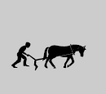
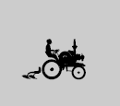
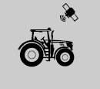
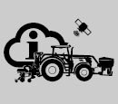
The focus of DAS is to define government measures needed to spread agriculture 4.0
1.0
„Work intensive”
2.0
„Green revolution”
3.0
„Precision farming”
4.0
„Smart farming”
Labor intensive farming with low productivity
Supplies the popultion with food but it’s operation needed a third of the population
Fertilizers, pesticides and more effective farming machines appeared as relatively inexpensive inputs and dramatically increased output
Precision farming allows to precisely track changes in portions of a field instead of field-wide tracking and the individual handling of animals instead of the entire stock
Automatic steering’s accuracy has reached 1 cm
Detection and regulation, crop yield measurement, variable volume of application (VRT).
Telemetrics/remote sensing, logistics optimisation of farms
Data processing
Agriculture 4.0 is based on the internal and external integration of agricultural operations
Cloud services allow to store and easily access large amounts of data and powerful applications analyse that data
smart technologies have become almost standard on tractors, harvesters and other devices
Cheap and advanced sensors
Cloud based services
Big data analysis
New algorithms that transform data into valuable information to optimize the product and the production process

Slide 4
DAS 1.0 main goals
Contribute to improving the efficiency of agricultural production
Spread the use of existing ICT solutions
Spread the use of existing R&D results
Create information flow between research and production
Increase the domestic and international market share of the Hungarian IT industry
Exploiting the benefits of advancing ICT
Helps in assessing and managing risks

Slide 5
DAS 1.0 was developed in 6 steps through 3 phases
I. phase
II. phase
III. phase
Opportunities provided by ICT advancement
National vision of e-Agriculture
Action plan
Monitoring and assessment plan
Digital Agricultural Strategy
National vision of Agriculture
I. phase – situation analysis, emphasis on the opportunities provided by information services
II. phase – vision, definition of goals, developing an action plan, and developing a monitoring and assessment plan
III. phase – developing the strategy

Slide 6
During methodology design, five areas were identified whose collaboration can provide efficiency gains
Coordination, cooperation
research, development, innovation, market, subsidization
Production
Farm
Product chain
Specialist system
Government
Tools to support production, applications that directly support farming, by automatic or semi-automatic interventions
Farm-level production-management systems that provide information to the management of farms, support decision making and integrate individual processes at producer level
Systems helping product chain integration, which support the integration process, helping both the farmer and the integrator, if necessary linking to the production level systems
Systems that provide background information for producers, farmers and integrators, collect and analyze data generated at producer level
Government systems that support administrative, registration processes between administration and farmers (eg support, product track audits)

Slide 7
Assessment of participators
 | Opportunities and expectations | Interfering factors | Necessary development
Production | There are ready technological solutions Spreading the solutions Cost reduction, profit maximalisation Yield enhancement Favorable profitability situation Environmental factors, sustainability Risk reduction Opportunity for export, expansion abroad (product, know-how, ICT) | lack of human capital non-targeted grants lack of consultants not a favorable age composition lack of standards IT developments are only limited in support RTK is expensive lack of mobile coverage lack of agronomic knowledge precision management is very machine-centered, IT integration is lacking lack of cost-based decision | standardization training for producers and consultants restructuring of support systems (after 2020, subsidies from VP, use of modern technology) supporting the process, not just technology
Farm | the existence of corporate governance systems management support, cost reduction, profit maximization risk reduction | small farm size lack of knowledge lack of standardization (GIS, inter-manufacturing) lack of cost-based decision | standardization training (consultants, producers) initial training and further training leadership training generating change, to make cost-based approach more powerful than young people change agronomist training (pursuit of efficiency)
Product chain | making sciencie-based forecasts; taking foreign knowledge, adaptation; promoting organization; online regulated trading (purchasing and selling online communities) | low organization black market lack of coordination regulation lack of trust unified data model | awareness regulatory incentives introducing incentive incentives collecting transaction data
Specialist system | ready-made technology systems harmonization between systems user-friendly solutions community data sharing open data solutions | low degree of interoperability systems with different degrees of development (paper vs. digital) many isolated systems test system is not user-friendly input data is not always real regulatory requirements, accounting policy vs. farming policy (eg tractor driver specifications) | establishing relationships between systems national data asset management, returning data to users
Government | user-friendly solutions, one data once integrated and interoperable solutions cheap (free), online availability of central databases the role of public administration in knowledge transfer master data management | uncertainty of the regulatory environment privacy, data security, privacy; lack of data assets policy rapid technological development is not followed by regulation | human resource development Organizational development development of communication within public administration data protection regulation interface development

Slide 8
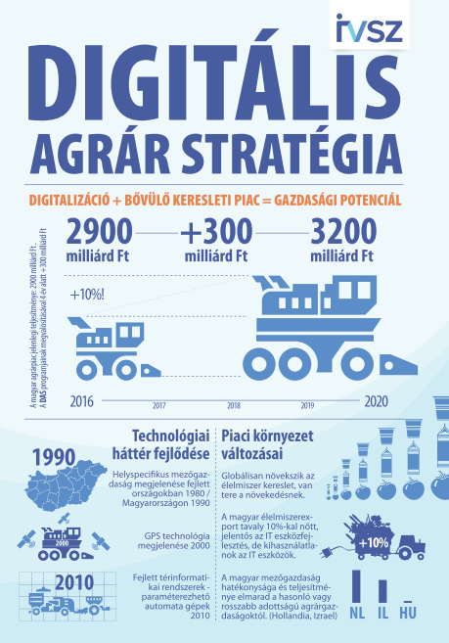
DAS 1.0 was presented by IVSZ to the press, to professional audience and politicians
Completed work was presented to the press 06.19.2016.
Press highlighted the novelty of the strategy
The strategy was introduced at multiple conferences

Slide 9
Digital Welfare Program 2.0 is created to support every citizen and enterprise in Hungary so they get on the winning side from digitalisation
Digital Infrastucture can be accessed by everyone in an affordable manner;
acquiring and continually developing basic digital skills will be possible;
strengthening of digital economy, which is playing an increasingly important role in the expansion of competitiveness, growth and employment
availability of electronic administrative developments and services meeting citizen’s needs (digital state)
Digital Welfare
Digital competencies
Digital economy
Digital state
Digital infrastructure

Slide 10
DAS 2.0 assessment phase identified three pillars whose collaboration can provide efficiency gains
Production
Farm
Product chain
Tools to support production, applications that directly support farming, by automatic or semi-automatic interventions
Farm-level production-management systems that provide information to the management of farms, support decision making and integrate individual processes at producer level
Systems helping product chain integration, which support the integration process, helping both the farmer and the integrator, if necessary linking to the production level systems

Slide 11
Effects of the changes resulting from digitization significantly transform the technological and economic processes of the agricultural sector, employment and social relations
From a service, digitalisaton has grown to be a competitive factor
Agrarian digitalization began in the development of Industry 4.0 that supports production organization based on the needs of consumers
Vision, goals
Agricultural production
Farm
Product chain
Human resources
Research-development-innovation
Administrative and public services
Development policy, grants

Slide 12
„…the future of food economy is based on information and knowledge…” (Hungary’s Food Industry Concept 2017-2050)
By collecting, processing, automating and robotizing technological processes, it contributes to increasing the profitability of the food economy, including the agricultural production, in addition to the efficient use of available environmental resources
Goals
Agricultural production
Wider use of precision farming (S1)
Farm
Use of management control applications in farm management, preparation of decisions (S2)
Product chain
Product tracking systems and online business development (S3)
Strategic goals
Human resources
Development of digital competences of food business operators (H1.1)
Provision of digital agricultural advice to farmers (H1.2)
Research-development-innovation
Development of a Digital Agri-Innovation Environment (H2.1)
Development of a digital agrarian startup ecosystem (H2.2)
Horizontal goals
Administrative and public services
Reducing the cost of access to public and digital services (H3.1)
Legal deregulation for exploiting the potential of digital technology (H3.2)
Development of sector data collection and processing (H3.3)
Development policy, grants
Promotion of precision management (H4.1)

Slide 13
Intervention logic
Agricultural production
Farm
Product chain
Human resources
Developing digital competencies
Developing innovation ecosystem
Research-development-innovation
Developing digital competencies
Developing innovation ecosystem
Administrative and public services
Digital Agricultural Costs Reduction
Land cover data system
fruit cadastre
Adjusting to digital technology
Digital Cellar Registry
National Wine Database
ERDEINK - Forest Information Framework
Further development of the Fisheries Information System (HALir)
Crop estimation based on remote sensing
"Smart Test System"
Use of water resources
National Food Chain Reporting Center
E-commerce development
Development policy, grants
Development of the digitization of the sector

Slide 14
DAS 2.0's implementation is also supported by other projects currently implemented
Training of brand-independent agricultural information specialists in digital technologies
Designing the operation of the Digital Agrarian Academy, drawing up an operational plan, functions, organizational structure, quality assurance plan and budgeting
Agrarian Data Integration project, which is aimed at the assessment of agricultural data and information, is to enable the collection and processing data and information, possibly toll-free for agri-businesses, contributing to the increase of efficiency
Developing an effective form of grant for increasing the penetration of ICT in the agricultural economy and application, and compiling a proposal

Slide 15
Thank you for your attention!

