Slide 1
Overview of pre-event survey responses on examples of innovation for smallholders and family farms
Laszlo Gabor Papocsi
GAK / WeAreNet
FAO Expert consultation on knowledge sharing for agricultural innovations applicable for smallholders and family farmers in Europe and Central Asia
Godollo - Hungary, 10/09/2018 - 13/09/2018

Slide 2
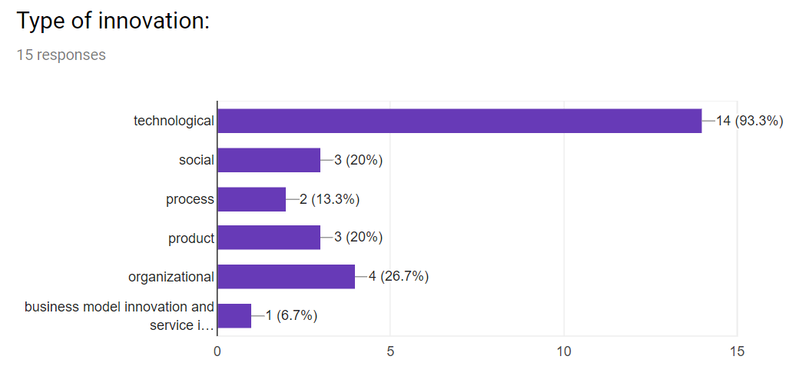

Slide 3
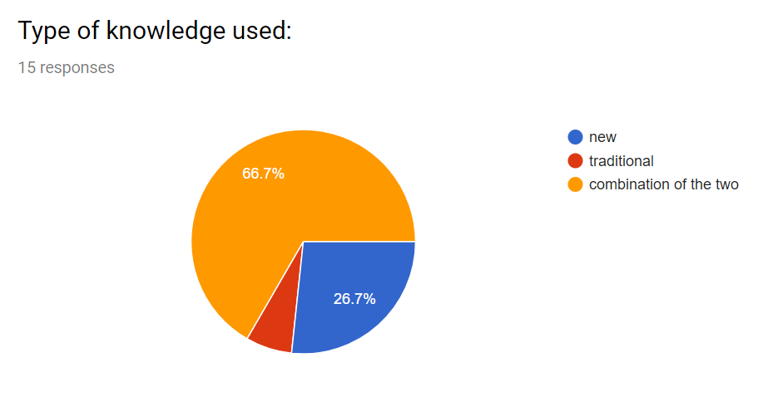

Slide 4
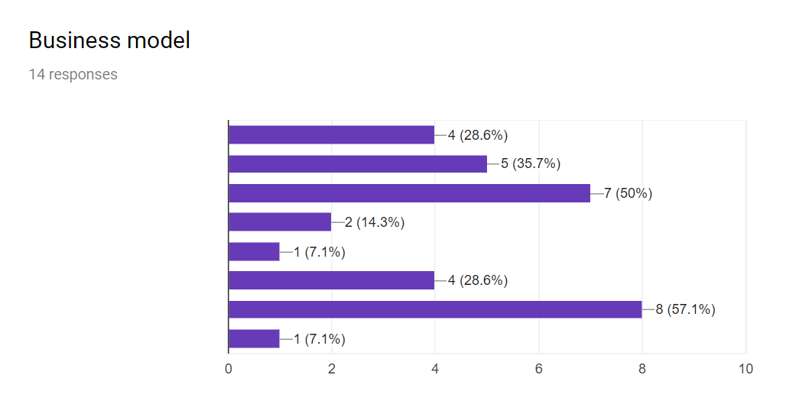
one-time sell
commercial service on a regular basis
advisory service on a regular basis
public-private partnership
vertical integration
cooperaitve
free to use / open source / community
Other:

Slide 5
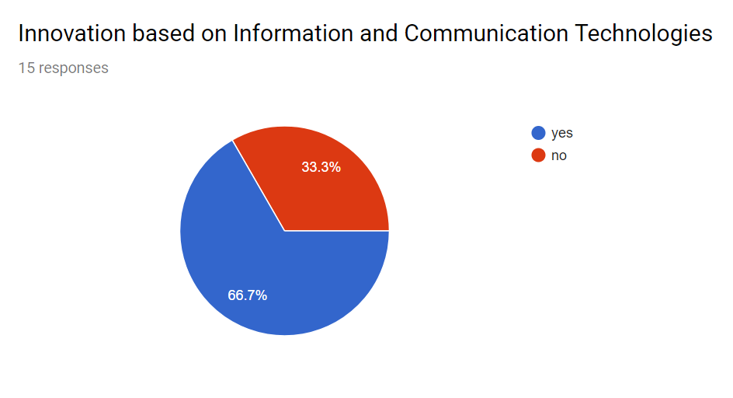

Slide 6
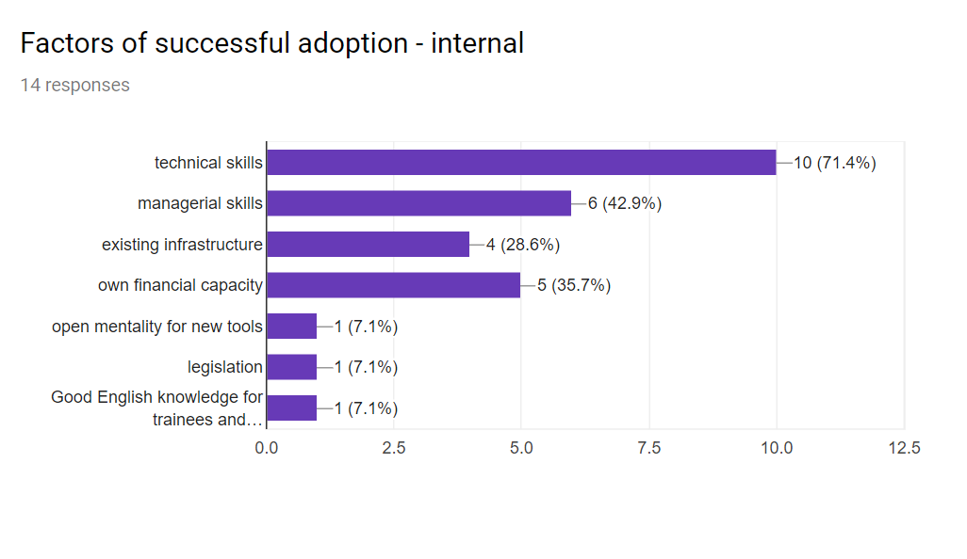

Slide 7
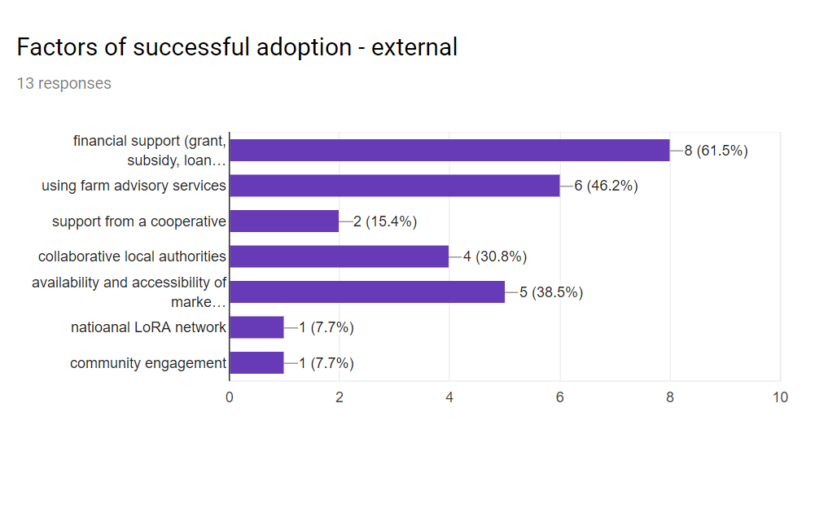

Slide 8
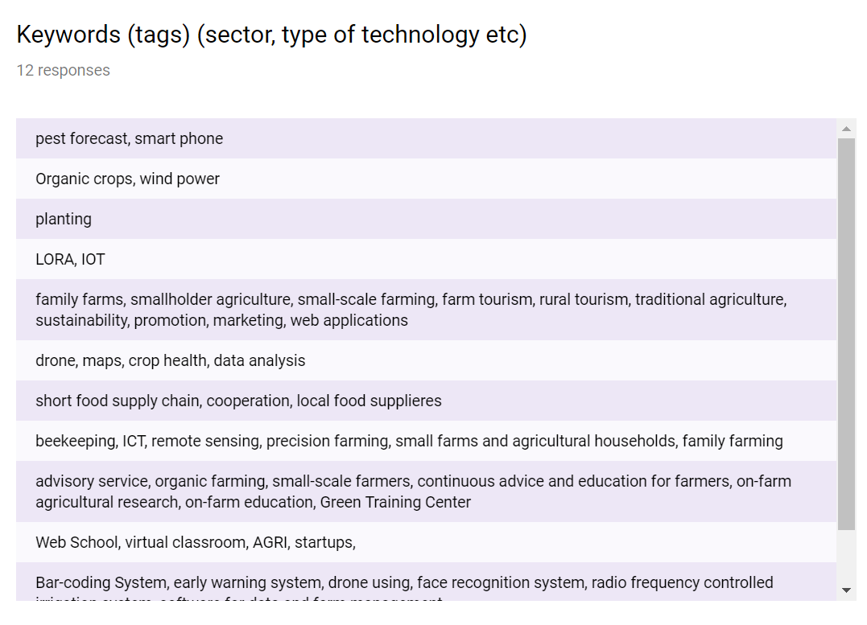

Slide 9
What is the innovation
Affordable remote monitoring of insect traps
Precise agriculture
Мeasures for adaptation to climate change
Wind powered water pump for an organic farm
Hand planter that includes 2 seed drums, and 1 fertilizer drum.
LoRA WAN private data communication network
Integrated search platform which offers a possibility to promote such family farms in Slovenia which provide farm holidays
Web platform that converts drone captured images of farm fields into crop health data.
The new social interactions between the producers and local community and the new way of selling the products.
Remote honey production control
Green Training Center (GTC) in Dzoraghbyur village, Armenia
Knowledge sharing for the use of renewable energy resources for further processing/preparing (drying ) of non-wood forest products
Virtual based tools and novel approach for learning and vocational training.
Digital usage in aggregated agricultural land:
LandVoc is a controlled vocabulary covering any concepts related to land governance.

Slide 10
Challenge
Small farmers cannot monitor numerous traps daily / weekly if their plots are scattered around the municipality / region
Knowledge of farmers; Infrastructure; Finances
To bring water from an irrigation system channel up to a higher elevation field without the use of costly and polluting technology such as diesel pumps.
Manual work too tiring, waste of inputs, inconsistent yield
Identifying and montoring cattles in the pastoral type of a grazing system, in remote places on the pastures of the Hungarian Puszta
Analysing drone captured images
Problems that smallholders had with the wholesalers.
Time and classic trail/error approach resulting in many hours and traveling costs for checking the beehives
Collection of big amounts of products with no profit
Prepare the training curricula that fits the needs and priority of target groups in different countries of the region, in order to attract as many users as possible
Low income and especially young farmers were tend to migrate to the urban cities.
As web aggregator, the Land Portal needs to map content from several sources into a common model.

Slide 11
Why for smallholders
Cheap, advisory assisted, easy to learn to use, can be applied based on open source guidance
More efficient and more productive
Has low to no operating costs, easily applied to most terrains and applicable to remote regions with poor infrastructure.
As "green seeder" part of the small farm toolbox, see URL
No monthly cost if own network is used, one network can serve a list of useful functions in the farm by bi-directional active low power sensors
Farm-tourism is an additional source of income for family farms.
Free/cheap and decrease knowledge barriers
Smallholders are participants of short food supply increasing their farm income.
Low cost solution of (almost) precision farming in beekeeping
Show smallholders an effective business model for commercial farming and help them adopt effective and efficient farming and business practices.
Create an opportunity for income generation activity
Training curricula will aim especially small holders, SMEs, young entrepreneurs
Digital agriculture is also an opportunity to solve the structural problems of agriculture in Turkey.

Slide 12
Thank you

