Slide 1
THE FAMILY FARMING KNOWLEDGE PLATFORM
www.fao.org/family-farming

Slide 2
Launched in June 2015 by the Food and Agriculture Organization of the United Nations (FAO), the Family Farming Knowledge Platform (FFKP) is one of the long lasting legacy of the 2014 International Year of Family Farming.
The FFKP gathers digitized quality information on family farming from all over the world, including – among others:
national laws and regulations;
public policies;
best practices;
relevant data and statistics;
researches;
articles and publications.
www.fao.org/family-farming

Slide 3
The Family Farming Knowledge Platform (FFKP) has been conceived to:
Providing a single access point for retrieving and sharing international, regional and national information
related to family farming
Enhancing informed
decision making
and research on family
farming-related policy
processes and practices
Allowing governments, researchers, NGOs, farmers' organizations, etc. to get international visibility on their work on family farming
www.fao.org/family-farming

Slide 4
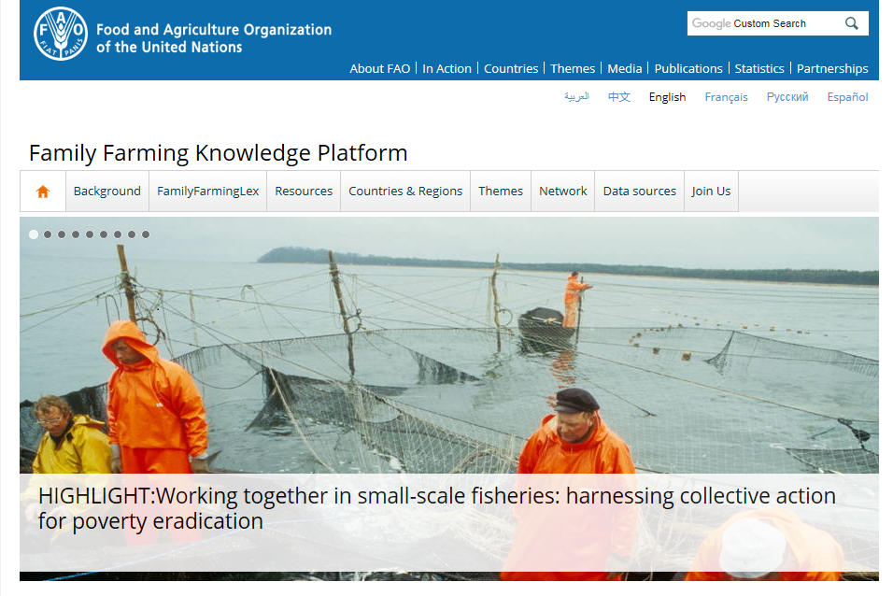
Intended for a wide range of users, the Family Farming Knowledge Platform is structured into nine sections:
Home page
Themes
Background
Network
FamilyfarmingLex
Data sources
Resources
Join us
Countries & Regions

Slide 5
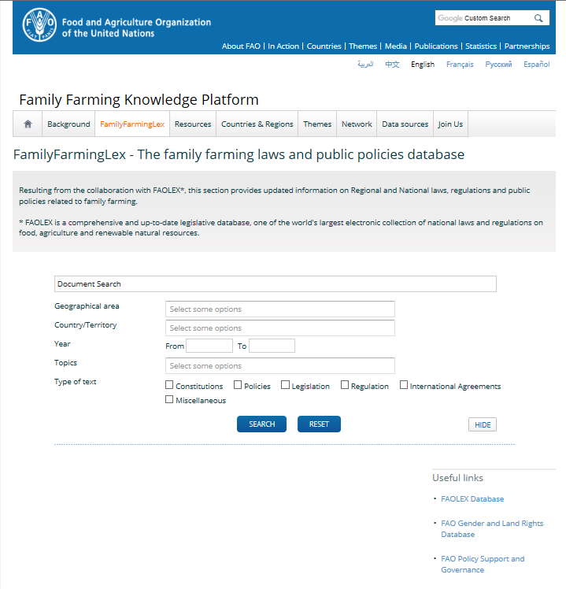
FamilyfarmingLex
The Family Farming Lex page includes updated information on:
Regional and National laws;
Regulations;
Public policies related to family farming.

Slide 6
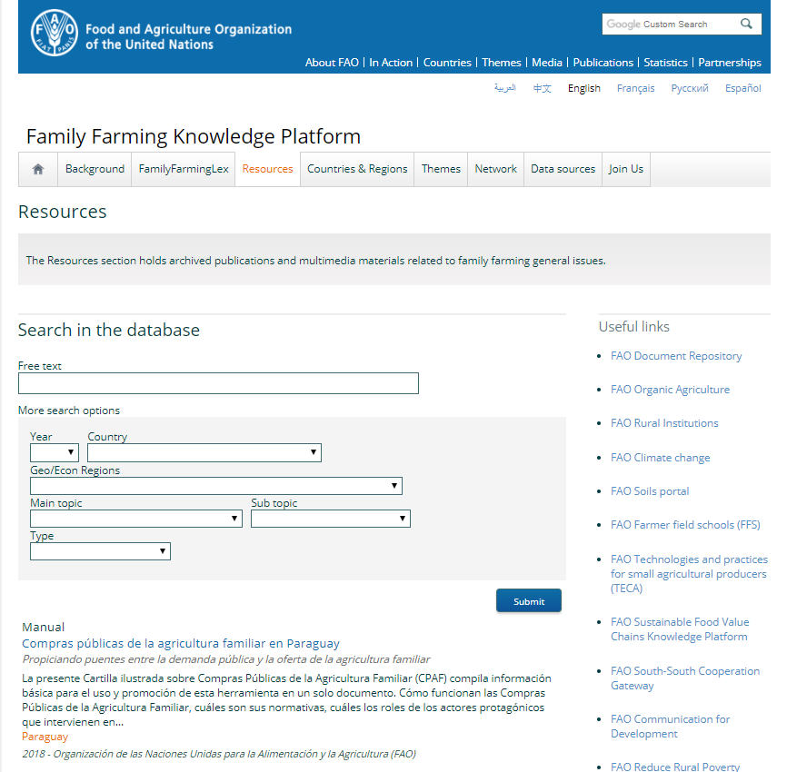
FamilyfarminLex
Resources
The Resources section holds archived publications (articles, case studies, manuals, reports, guidelines, newsletters, etc.) and multimedia materials related to family farming issues.

Slide 7
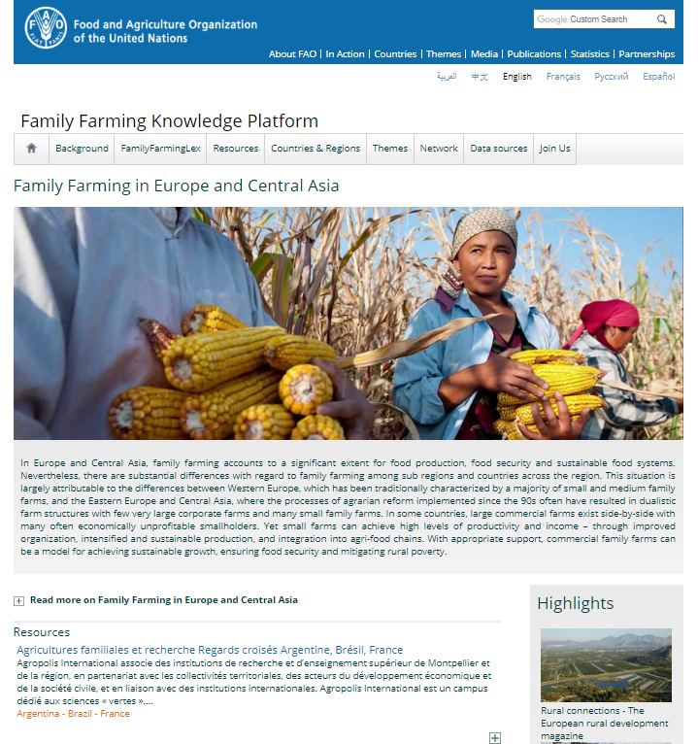
FamilyfarminLex
Countries & Regions
The Countries & Regions pages offer facts and information on family farming related issues by country (FAO Members and Associated Nations) and region.
The purpose is to offer a fast and reliable way to access country-specific information on family farming without the need to search in each section of the platform.

Slide 8
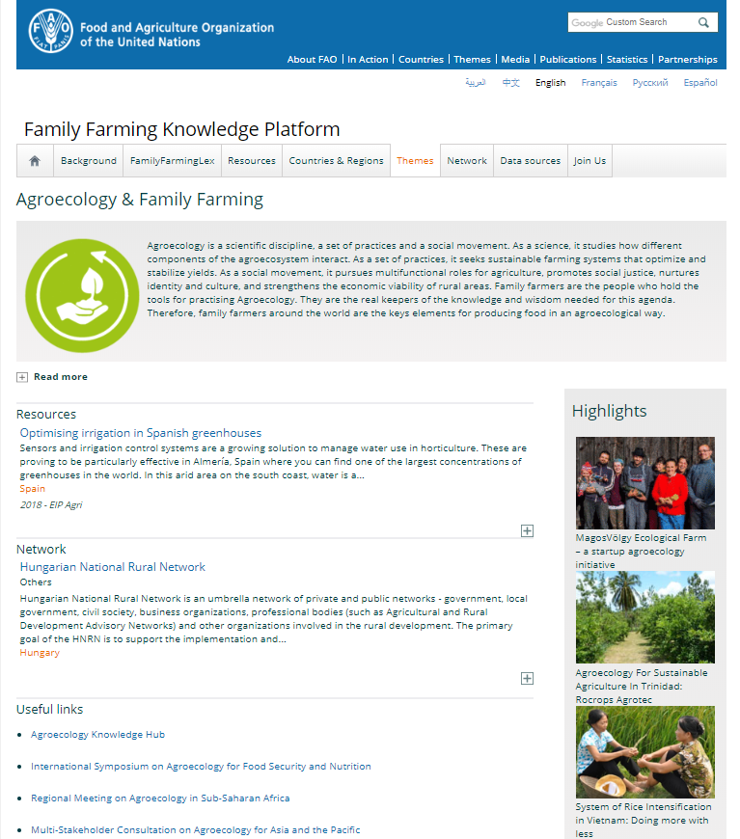
FamilyfarminLex
Themes
The Thematic pages provide information on a specific them related to family farming.
As for the Countries & Regions pages, the purpose is to allow the users to quickly retrieve specific information without the need to search in each section of the platform.

Slide 9
FamilyfarminLex
Network
The FFKP Network helps identifying and connecting key players from the same country or region.
By joining the FFKP Network, members are given the opportunity to get international visibility for their organization/association/cooperative through the FFKP.

Slide 10
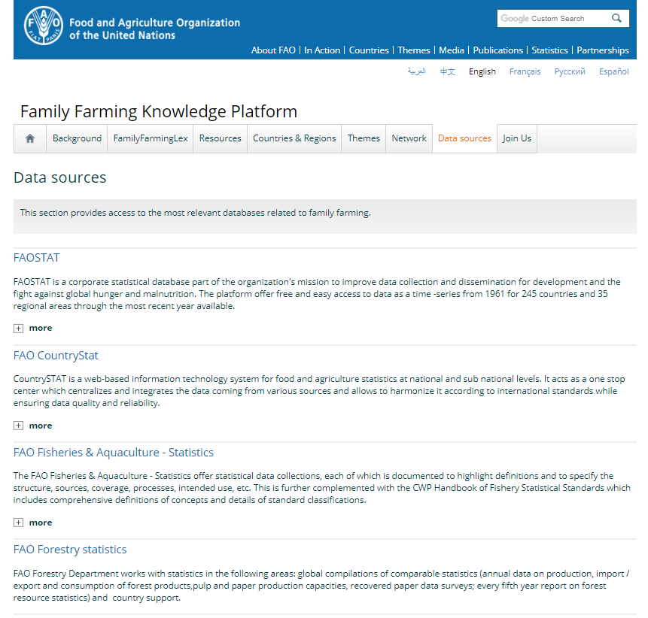
FamilyfarminLex
Data sources
The Data sources section provides access to the most relevant databases related to family farming.

Slide 11
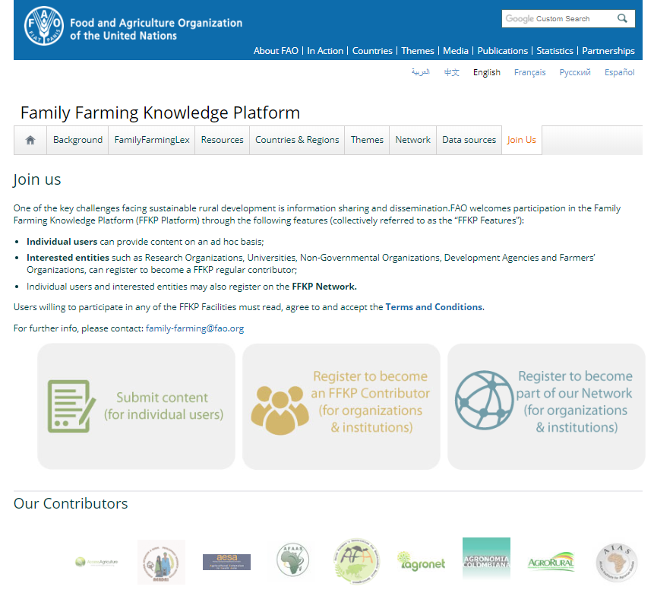
FamilyfarminLex
Join us
Through the Join us section:
Individual users can provide content on an ad hoc basis;
Interested entities such as Research Organizations, Universities, Non-Governmental Organizations, Development Agencies and Farmers’ Organizations, can register to become an FFKP regular contributor;
Individual users and interested entities may also register on the FFKP Network.

Slide 12
In line with its participatory nature, the Platform benefits from the active collaboration of all interested entities willing to take part to this project by sending factual, notable, verifiable (with cited sources) and neutrally presented content.
Through the appointment of National focal points, Governments participate to the initiative by directly uploading national policies, programs, articles, etc.
To this day, 104 Governments have appointed a focal points to liaise with the FFKP, of which 39 are from Europe and Central Asia (REU).
www.fao.org/family-farming

Slide 13
In addition, the FFKP benefits from the precious collaboration of its contributors.
Research organizations, universities, non-governmental organizations, development agencies and farmers’ organizations from all over the globe willing to be part of this project are given a direct access to the Platform to include up to date content on its database.
Presently, approximately 150 contributors worldwide - of which 57 from Europe and Central Asia Region - are sharing their knowledge through the FFKP.
www.fao.org/family-farming

Slide 14
In May 2018, the FFKP has released online its latest feature: the FFKP Network. The FFKP Network has been created for helping connect family farming key players (Farmers’ Organizations, Civil Society Associations, Cooperatives, Research Organizations, Universities, Non-Governmental Organizations, Development Agencies, Institutions, etc.) from the same country or region, encouraging them to explore areas of common interest that may serve as a basis to establish partnerships and collaborations among its members.
By joining the FFKP Network, members are given the opportunity to get international visibility for their organization/association/cooperative through the Family Farming Knowledge Platform.
The online registration is free and can be done by clicking on the following link:
http://www.fao.org/family-farming/contributor/en/

Slide 15
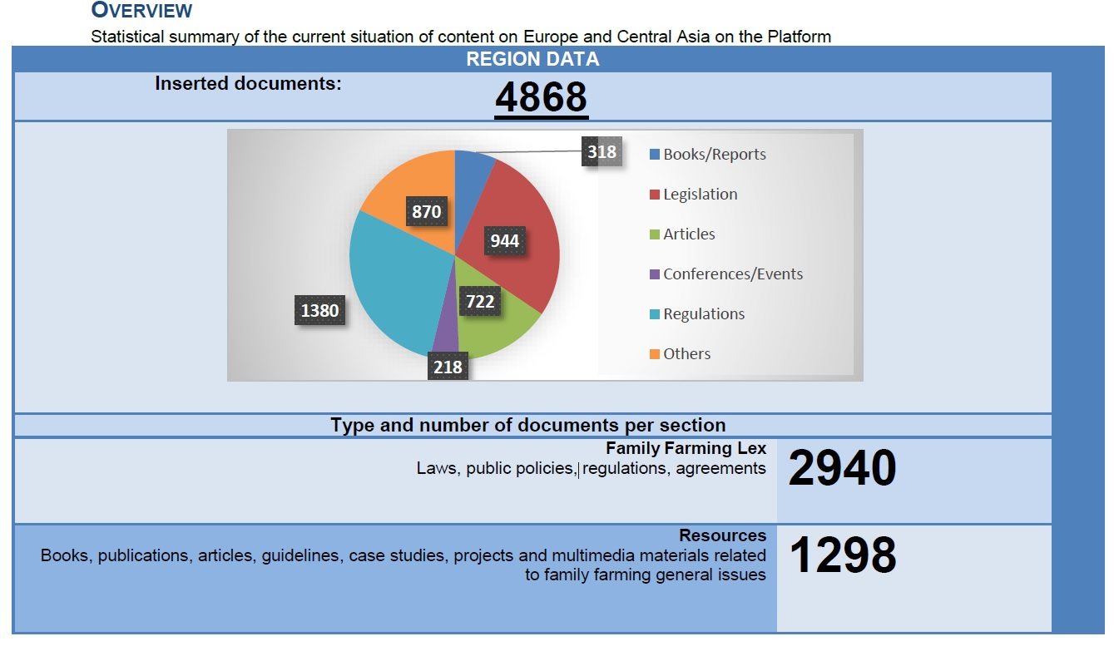
Thanks to these joined efforts, after three years online, the Platform, which today includes more than 20 000 content, is visited by some 30 000 users a month.
Types and number of documents
for Europe and Central Asia:
www.fao.org/family-farming

Slide 16
For any further information on the FFKP, please contact:
Family-farming@fao.org
Thank you!
www.fao.org/family-farming

